Slide 1
CORONA VIRUS ANALYSIS
Analyzing COVID-19 DATASET USING SQL
BY MIRACLE OGUNNUSI

Slide 2
TABLE OF CONTENT
Problem Statement
Dataset Description
Data Exploration and Analysis
Key Insights
Conclusion

Slide 3
Problem Statement
This project involves analyzing a COVID-19 dataset using SQL and data analysis skills. The task is to derive insights from the dataset containing information such as geographic location, dates, confirmed cases, deaths, and recoveries.

Slide 4
Dataset Description
Description of each column in dataset:
Province: Geographic subdivision within a country/region.
Country/Region: Geographic entity where data is recorded.
Latitude: North-south position on Earth's surface.
Longitude: East-west position on Earth's surface.
Date: Recorded date of CORONA VIRUS data.
Confirmed: Number of diagnosed CORONA VIRUS cases.
Deaths: Number of CORONA VIRUS related deaths.
Recovered: Number of recovered CORONA VIRUS cases.

Slide 5
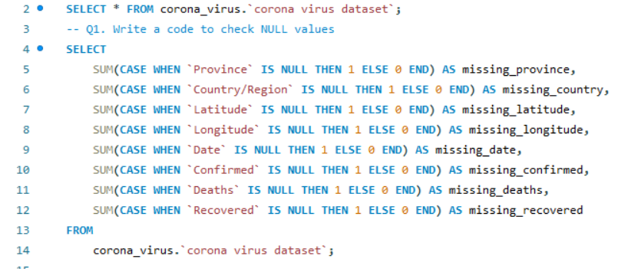
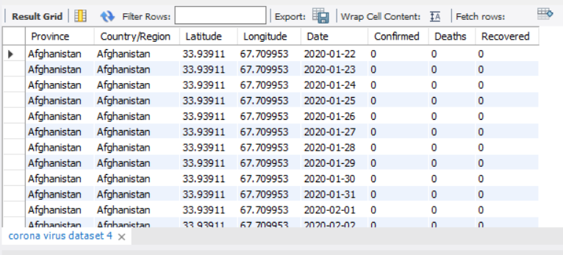
Data Exploration and Analysis
CHECKING MISSING VALUES/NULL VALUES
There are no missing/null values in this dataset

Slide 6
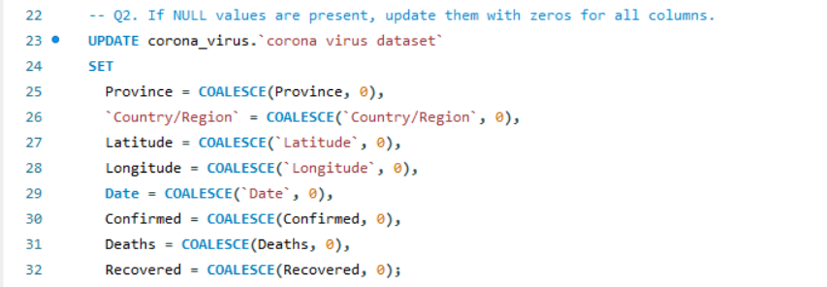
IF NULL VALUES ARE PRESENT, UPDATE THEM WITH ZEROS FOR ALL COLUMNS

Slide 7
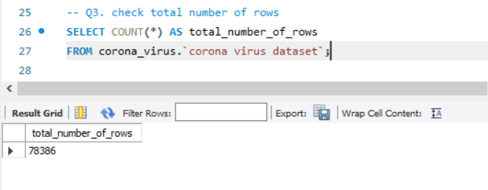
CHECK TOTAL NUMBER OF ROWS
The total number of rows in this dataset is 78,386 rows

Slide 8
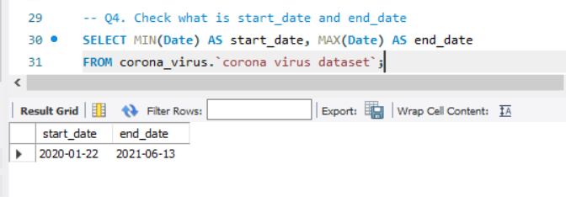
CHECKING START DATE & END DATE
The start date is 2020-01-22 while the end date is 2021-06-13

Slide 9
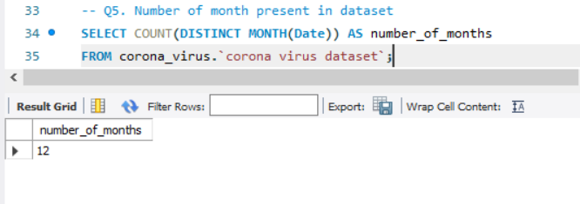
CHECKING FOR NUMBER OF MONTHS
There are 12 months in this dataset

Slide 10
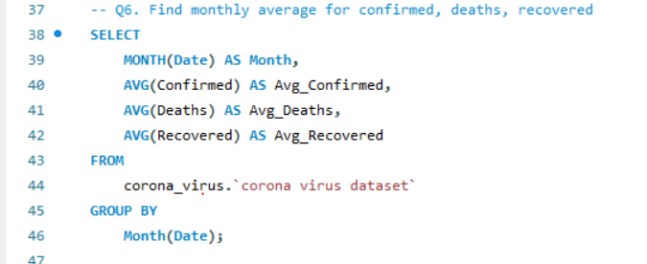
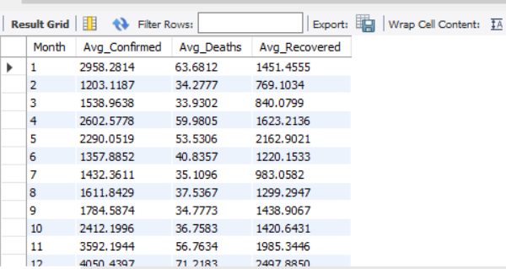
FINDING MONTHLY AVERAGE FOR CONFIRMED, DEATHS, RECOVERED

Slide 11
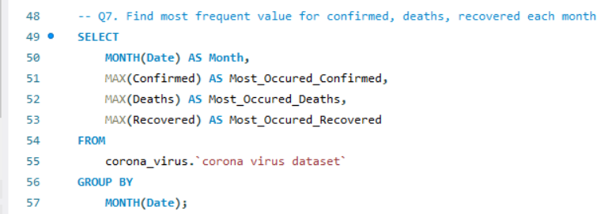
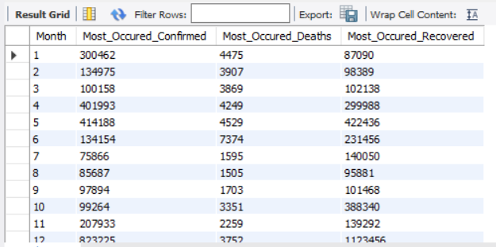
FIND MOST FREQUENT VALUE FOR CONFIRMED, DEATHS, RECOVERED EACH MONTH

Slide 12
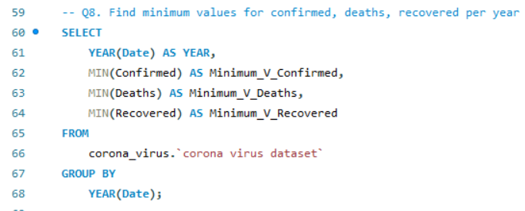
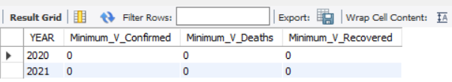
FIND MINIMUM VALUES FOR CONFIRMED, DEATHS, RECOVERED PER YEAR

Slide 13
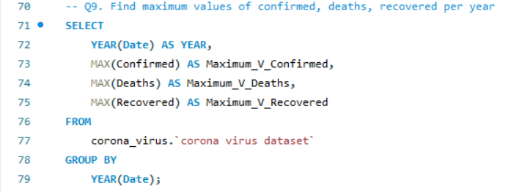
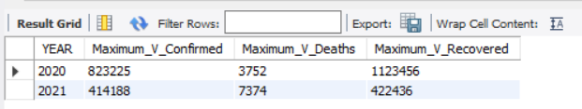
FIND MAXIMUM VALUES OF CONFIRMED, DEATHS, RECOVERED PER YEAR

Slide 14
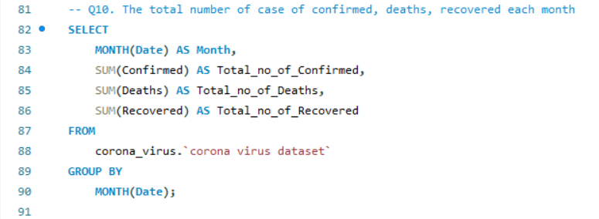
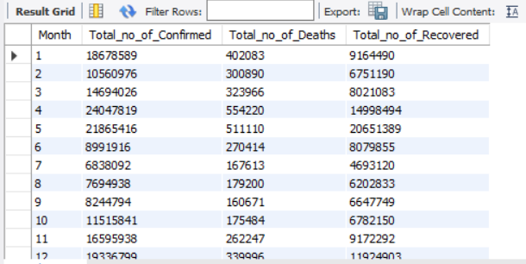
THE TOTAL NUMBER OF CASE OF CONFIRMED, DEATHS, RECOVERED EACH MONTH

Slide 15
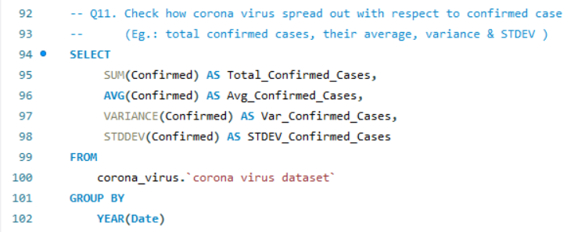
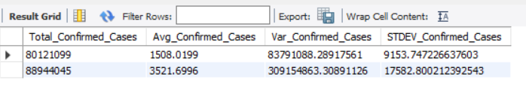
CHECK HOW CORONA VIRUS SPREAD OUT WITH RESPECT TO CONFIRMED CASE

Slide 16
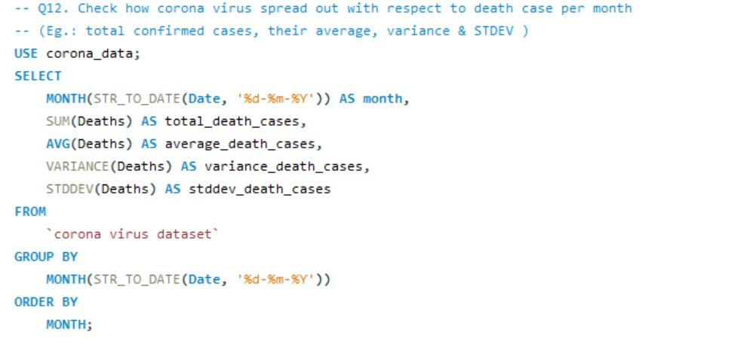
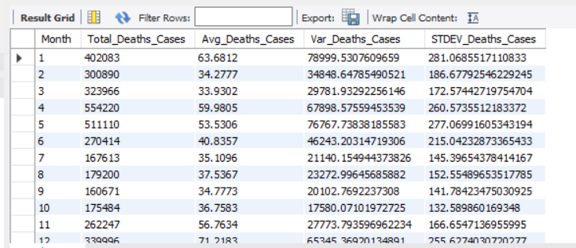
CHECK HOW CORONA VIRUS SPREAD OUT WITH RESPECT TO DEATH CASE PER MONTH

Slide 17
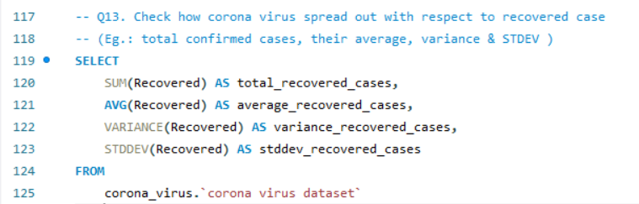
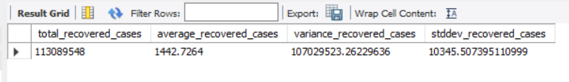
CHECK HOW CORONA VIRUS SPREAD OUT WITH RESPECT TO RECOVERED CASE

Slide 18
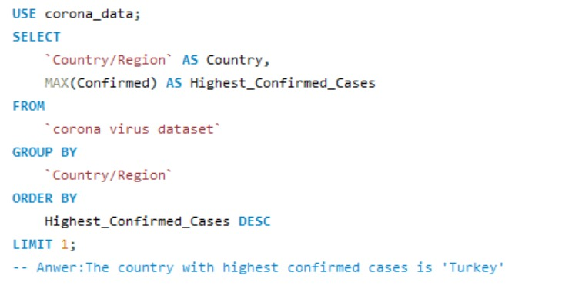
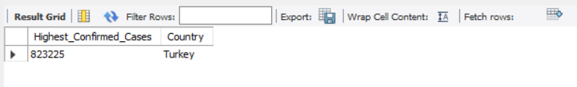
FIND COUNTRY HAVING HIGHEST NUMBER OF THE CONFIRMED CASE

Slide 19

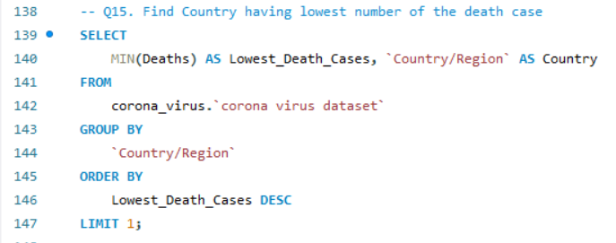
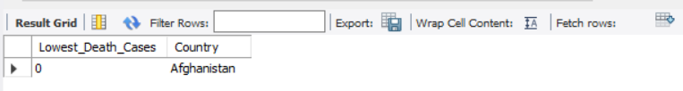
FIND COUNTRY HAVING LOWEST NUMBER OF THE DEATH CASE

Slide 20
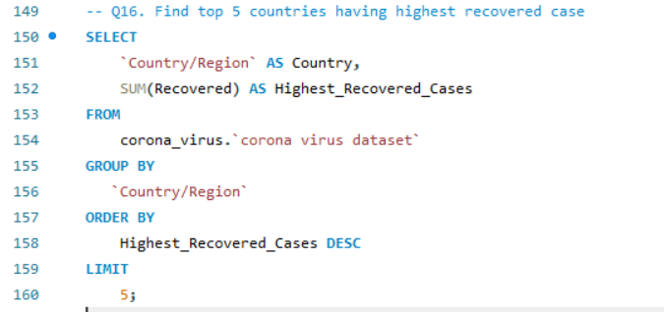
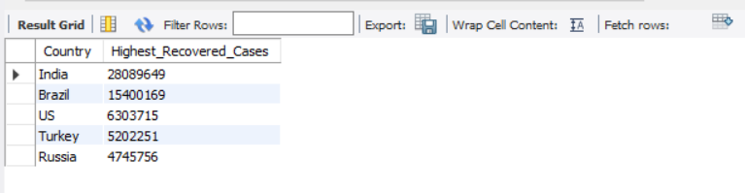
FIND TOP 5 COUNTRIES HAVING HIGHEST RECOVERED CASE

Slide 21
KEY INSIGHTS
Confirmed Cases Analysis
The highest confirmed case average occurred in the 10th month, totaling 4050.4397, while the lowest average was in the 2nd month, with 1203.1187 cases. The highest single-day confirmed case count was 823225 in the 10th month, and the lowest was 75866 in the 7th month. The overall highest confirmed case count was 24047819 in the 4th month, with the lowest being 6838092 in the 7th month. Turkey reported the highest number of confirmed cases.

Slide 22
KEY INSIGHTS
Deaths Analysis
The average number of deaths peaked in the 12th month at 71.2183, with the lowest average in the 3rd month at 33.9302. The highest frequency of deaths in a single day was 7374 in the 6th month, and the lowest was 1505 in the 8th month. The highest total number of deaths occurred in 2021, with the lowest in 2020.

Slide 23
KEY INSIGHTS
Recovered Cases Analysis
The highest average number of recovered cases was in the 12th month, totaling 2497.8850, while the lowest average was in the 2nd month at 769.1034. The highest total number of recovered cases was in 2020, with the lowest in 2021. The total number of recovered cases peaked at 1123456 in the 12th month, with the lowest being 87090 in the 1st month.

Slide 24
GENERAL INSIGHTS
There were no null values in the dataset. The dataset spans from January 22, 2020, to June 13, 2021. There were no minimum values recorded for confirmed, deaths, or recovered cases. The total spread of Covid-19 amounted to 169,065,144 confirmed cases. The countries with the highest reported cases are India, Brazil, the United States, Turkey, and Russia. These insights provide a comprehensive overview of the COVID-19 dataset, highlighting trends in confirmed cases, deaths, and recoveries across different months and years, as well as notable statistics for individual countries.

Slide 25
CONCLUSION
This analysis provides valuable insights into the dynamics of the pandemic, highlighting temporal trends, regional variations, and the impact of public health interventions. These findings can guide future pandemic preparedness, response, and recovery efforts.

Slide 26
THANK YOU.

